Slide 1
Topological Models for Safety Analysis
Dan Maljovec
5/10/19
Notes:
Thank you all for coming to my defense today which is on the topic of topological models for safety analysis. Largely, I am going to be talking about exploratory data analysis for multidimensional scalar function data.

Slide 2
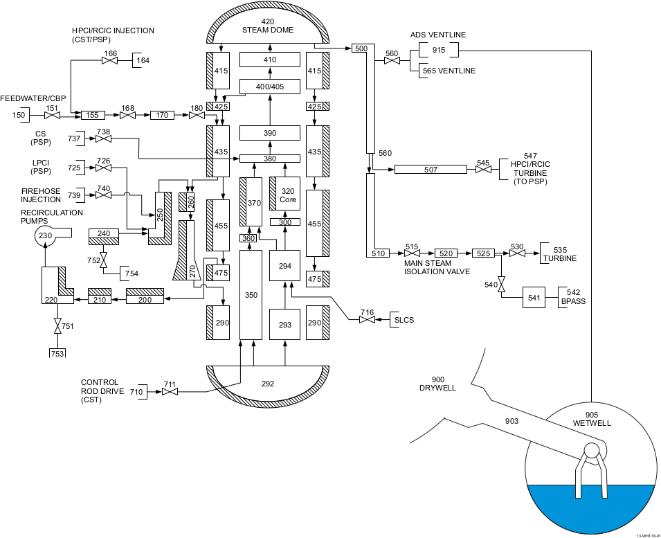
Problem Space Description
Inputs
System
Output
Sample
Decision
Model
Analyze
Notes:
We are operating under the assumption that we have some multidimensional input space where we may or may not have control over the parameters and a functional relationship with one or more target outputs, and we want to understand the relationships well enough to inform some decision process.
For example, a lot of my work has dealt with working with nuclear engineers who study the safety and proliferation of our now aging nuclear infrastructure. They often run safety simulations to understand when and how our nuclear power plants are at risk and how they can be made safer. These are often multi-million dollar decisions and should not be made lightly.
This is where I come in: the work I have been a part of is this exploratory data analysis pipeline which I am describing on this slide as occuring in three phases.
In the first phase, we generate the data, and this can be done in several different ways. It could be anything from space-filling designs to the extreme case where we may just be able to collect data from fixed sensors or something where the data is determined by physical constraints. In particular, I want to spend some time today talking about some work I did early on in my tenure dealing with adaptive sampling, this work has been summarized in two different publications.
Next, once we have collected data, we have the option of building a model on that data. Here, we are talking about regressors or classifiers depending on the type of data represented by the output. For this portion of the talk, I want to focus on this notion of structural modeling where we impose a geometric structure on our data.
Lastly, and arguably the most important phase is the analysis we perform on the data and/or model. Here, we could be looking at summary statistics, correlations and sensitivities between inputs and outputs, and various visualizations to support these and other tasks.

Slide 3
Problem Space Description
Inputs
System
Output
Space-Filling Design
Design of Experiments
Adaptive Sampling
Collecting Available Data
Sample
Model
Analyze
Statistics
Correlation
Sensitivity
Validation
Visualization
Classification/Regression Model
Structural Model
Statistical Modeling
Reduced Order Modeling
Decision
Notes:
We are operating under the assumption that we have some multidimensional input space where we may or may not have control over the parameters and a functional relationship with one or more target outputs, and we want to understand the relationships well enough to inform some decision process.
For example, a lot of my work has dealt with working with nuclear engineers who study the safety and proliferation of our now aging nuclear infrastructure. They often run safety simulations to understand when and how our nuclear power plants are at risk and how they can be made safer. These are often multi-million dollar decisions and should not be made lightly.
This is where I come in: the work I have been a part of is this exploratory data analysis pipeline which I am describing on this slide as occuring in three phases.
In the first phase, we generate the data, and this can be done in several different ways. It could be anything from space-filling designs to the extreme case where we may just be able to collect data from fixed sensors or something where the data is determined by physical constraints. In particular, I want to spend some time today talking about some work I did early on in my tenure dealing with adaptive sampling, this work has been summarized in two different publications.
Next, once we have collected data, we have the option of building a model on that data. Here, we are talking about regressors or classifiers depending on the type of data represented by the output. For this portion of the talk, I want to focus on this notion of structural modeling where we impose a geometric structure on our data.
Lastly, and arguably the most important phase is the analysis we perform on the data and/or model. Here, we could be looking at summary statistics, correlations and sensitivities between inputs and outputs, and various visualizations to support these and other tasks.

Slide 4
Problem Space Description
Inputs
System
Output
Sample
Topology
Model
Analyze
Decision
Notes:
So, scientific research at its most basic level is about observing phenomena occuring in nature and our surroundings through relationships of different quantities of interest. For our purposes, we are interested in studying the relationship between some input parameters that we have direct control over and observable target outputs, we believe to be correlated to a subset of those inputs. We perform our experimental design and the end result is some enhanced approximation or theory about the relationship.
We are interested in what is happening in this middle box, so if we lift the covers and look a bit more closely we see three major componenets of the experimental design process: Explore, Analyze, and Synthesize.

Slide 5
Sampling Publications
Inputs
System
Output
Sample
Adaptive Sampling with Topological Scores.
D. Maljovec, B. Wang, A. Kupresanin, G. Johannesson, V. Pascucci, and P-T Bremer. IJUQ, 3(2), pages 119-141, 2013
Adaptive Sampling Algorithms for Probabilistic Risk Assessment of Nuclear Simulations.
D. Maljovec, B. Wang, D. Mandelli, P-T Bremer, and V. Pascucci. PSA, 2013.
*First Runner-up for Best Student Paper Award
Model
Analyze
Decision
Notes:
So, scientific research at its most basic level is about observing phenomena occuring in nature and our surroundings through relationships of different quantities of interest. For our purposes, we are interested in studying the relationship between some input parameters that we have direct control over and observable target outputs, we believe to be correlated to a subset of those inputs. We perform our experimental design and the end result is some enhanced approximation or theory about the relationship.
We are interested in what is happening in this middle box, so if we lift the covers and look a bit more closely we see three major componenets of the experimental design process: Explore, Analyze, and Synthesize.

Slide 6
Analysis Publications
Rethinking Sensitivity Analysis of Nuclear Simulations with Topology.
D. Maljovec, B. Wang, P. Rosen, A. Alfonsi, G. Pastore, C. Rabiti, and V. Pascucci. PacificVis, 2016.
Visualizing High-Dimensional Data: Advances in the Past Decade.
*D. Maljovec, *S. Liu, B. Wang, P-T Bremer, and V. Pascucci. Eurographics Conference on Visualization (EuroVis), STAR - State of the Art Report, 2015.
*Joint First Authors
Analyzing Simulation-Based PRA Data Through Clustering: a BWR SBO Case Study.
D. Maljovec, S. Liu, B. Wang, V. Pascucci, P-T Bremer, D. Mandelli and C. Smith. PSAM, 2014. Extended Journal version: Reliability Engineering & System Safety (RESS), 2015.
Analyzing Dynamic Probabilistic Risk Assessment Data through Clustering.
D. Maljovec, B. Wang, D. Mandelli, P-T Bremer, and V. Pascucci. PSA, 2013.
ND²AV: an Analysis for the National Ignition Campaign.
P-T Bremer, D. Maljovec, A. Saha, B. Wang, J. Gaffney, B. Spears, and V. Pascucci. Computing and Visualization in Science, 17(1), Pages 1-18, 2015
Exploration of High-Dimensional Scalar Function for Nuclear Reactor Safety Analysis and Visualization.
D. Maljovec, B. Wang, V. Pascucci, P-T Bremer, M. Pernice, D. Mandelli, and R. Nourgaliev, M&C 2013
Inputs
System
Output
Sample
Model
Analyze
Decision
Notes:
So, scientific research at its most basic level is about observing phenomena occuring in nature and our surroundings through relationships of different quantities of interest. For our purposes, we are interested in studying the relationship between some input parameters that we have direct control over and observable target outputs, we believe to be correlated to a subset of those inputs. We perform our experimental design and the end result is some enhanced approximation or theory about the relationship.
We are interested in what is happening in this middle box, so if we lift the covers and look a bit more closely we see three major componenets of the experimental design process: Explore, Analyze, and Synthesize.

Slide 7
Modeling Publications
On the Applicability of Proximity Graphs for Multidimensional Data Analysis.
D. Maljovec, D. Wang, P-T Bremer, and V. Pascucci, SciVis 2019.
Scalable Topological Data Analysis and Visualization for Evaluating Data-Driven Models in Scientific Applications.
S. Liu, D. Wang, D. Maljovec, R. Anirudh, J. Thiagarajan, S. Jacobs, B. Van Essen, D. Hysom, J-S Yeom, J. Gaffney, J.L. Peterson, P. Robinson, H. Bhatia, V. Pascucci, B. Spears, and P-T. Bremer, VAST 2019).
*Under Review
Reduced Order Model and PRA: A Multi-Unit Perspective.
D. Mandelli, D. Maljovec, and A. Alfonsi. ANS Winter Mtg 2018.
Integration of Fault-Trees and Event-Trees into Dynamic PRA.
D. Mandelli, D. Maljovec, A. Alfonsi, C. Wang, Z. Ma, C. Parisi, and C. Smith. ANS Summer Mtg 2018.
An Overview of Reduced Order Modeling Techniques for Safety Applications.
D. Mandelli, A. Alfonsi, P. Talbot, C. Wang, D. Maljovec, C. Smith, C. Rabiti. ESREL 2017.
Inputs
System
Output
Sample
Model
Analyze
Decision
Notes:
So, scientific research at its most basic level is about observing phenomena occuring in nature and our surroundings through relationships of different quantities of interest. For our purposes, we are interested in studying the relationship between some input parameters that we have direct control over and observable target outputs, we believe to be correlated to a subset of those inputs. We perform our experimental design and the end result is some enhanced approximation or theory about the relationship.
We are interested in what is happening in this middle box, so if we lift the covers and look a bit more closely we see three major componenets of the experimental design process: Explore, Analyze, and Synthesize.

Slide 8
Application/Decision Publications
Inputs
System
Output
Mining Data in a Dynamic PRA Framework
D. Mandelli, D. Maljovec, A. Alfonsi, C. Parisi, P. Talbot, J. Cogliati, C. Smith, and C. Rabiti. Progress in Nuclear Energy, Volume 108, Pages 99-110, 2018.
Analysis of Time Dependent Data and PRA
D. Mandelli, D. Maljovec, A. Alfonsi, C. Picoco, C. Smith, and C. Rabiti. ANS Winter Mtg 2017.
High-Dimensionality Reduction for Multi-physics Application Under the RAVEN Framework
C. Wang, P. Talbot, C. Rabiti, A. Alfonsi, D. Mandelli, J. Cogliati, D. Maljovec, and R. Kinoshita. ANS Winter Mtg 2017.
An Overview of Methods to Analyze Dynamic PRA Data
D. Mandelli, D. Maljovec, C. Parisi, A. Alfonsi, C. Smith, Cristian Rabiti. ESREL 2017.
Dynamic PRA of a Multi-Unit Plant
D. Mandelli, C. Parisi, A. Alfonsi, D. Maljovec, S. St. Germain, R. Boring, S. Ewing, C. Smith, C. Rabiti. PSA 2017.
Sample
Model
Analyze
Decision
Notes:
So, scientific research at its most basic level is about observing phenomena occuring in nature and our surroundings through relationships of different quantities of interest. For our purposes, we are interested in studying the relationship between some input parameters that we have direct control over and observable target outputs, we believe to be correlated to a subset of those inputs. We perform our experimental design and the end result is some enhanced approximation or theory about the relationship.
We are interested in what is happening in this middle box, so if we lift the covers and look a bit more closely we see three major componenets of the experimental design process: Explore, Analyze, and Synthesize.

Slide 9





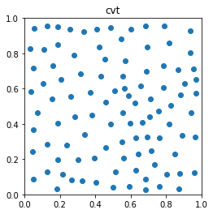
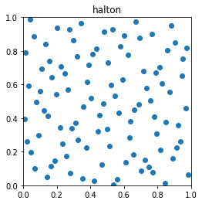
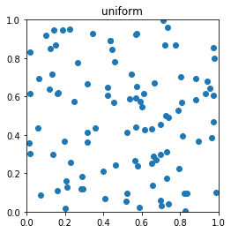
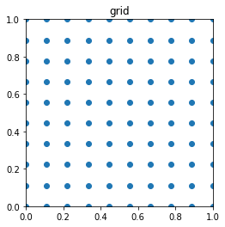
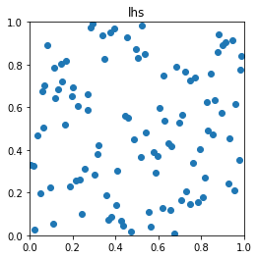
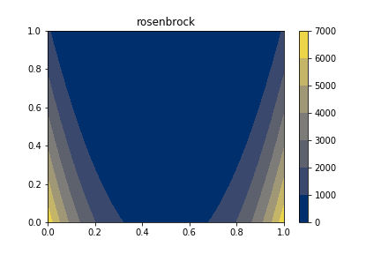
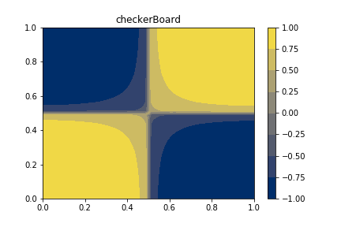
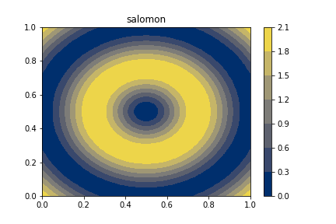

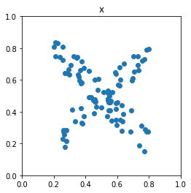
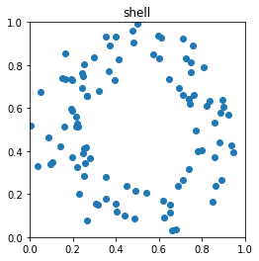
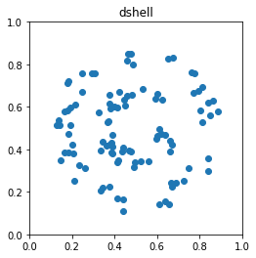
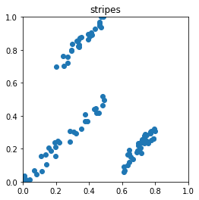
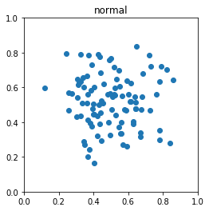
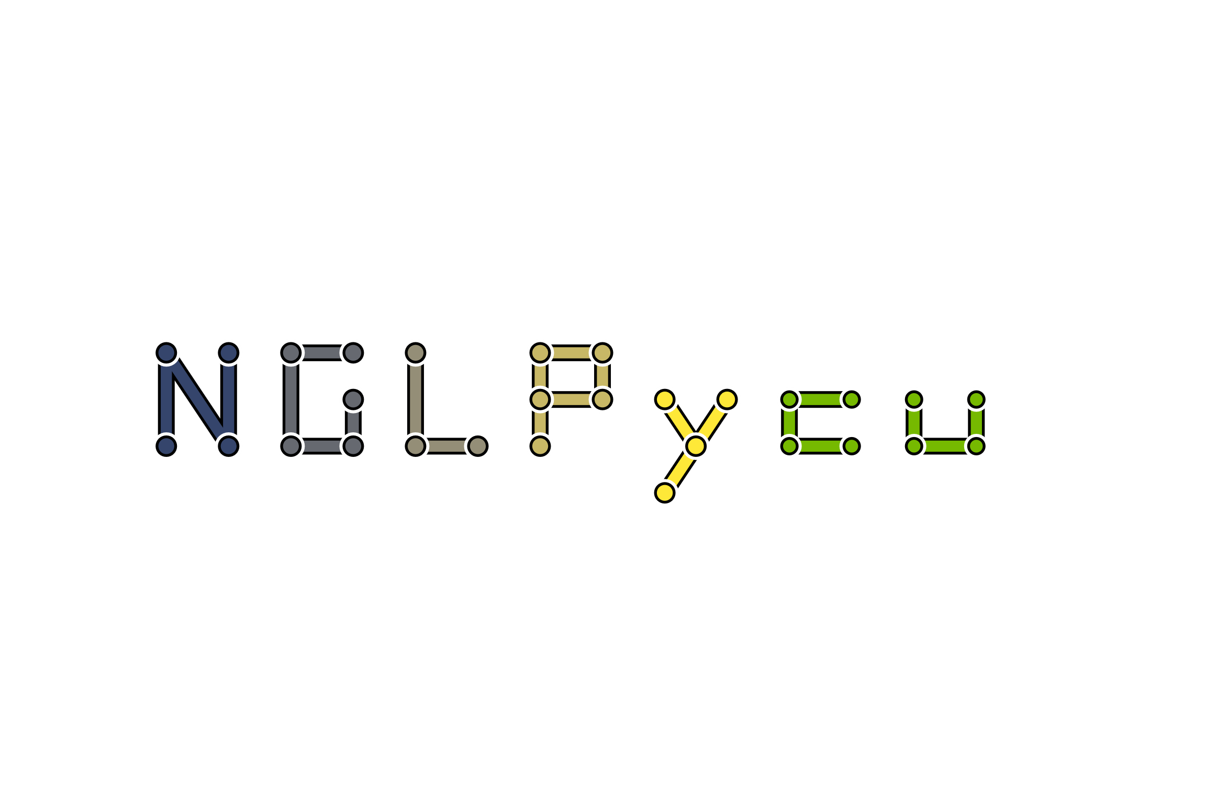
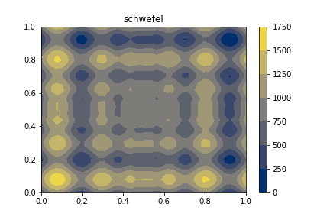
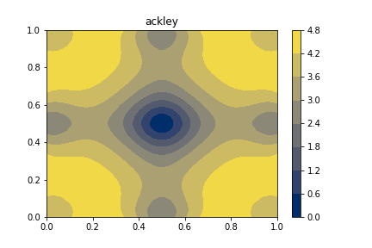
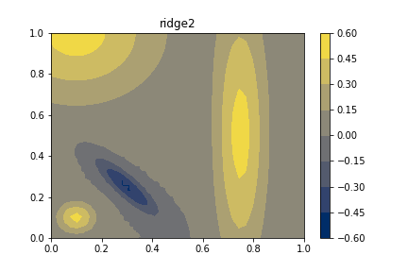
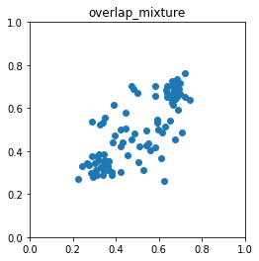
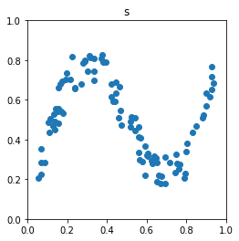
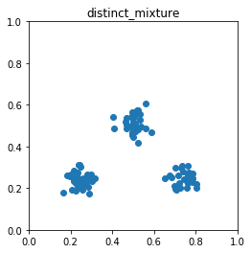
Contributions
17 Peer-Reviewed Publications + 1 Tech Report
7 First author papers
3 More under review (1 first author)
Techniques are/were used in:
Nuclear power plant risk assessment
Nuclear fusion research
Interned at 3 National Laboratories
Contributed to 3 National Lab-sponsored Open Source Projects
Authored 4 Open Source Projects
Hydrology uncertainty analysis
Sampling for catalyst design experiments
NDN
2
Samply
FlatPy
Notes:
Here is a list of my current publications, and for today's talk I am going to focus on talking about only a few of them which I have highlighted here plus some additional yet to be published efforts.

Slide 10
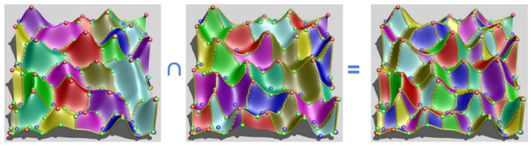



Morse and Morse-Smale Complex
Morse Complex of f
Partitioning such that all integral lines within a cell have the same destination
Local Maximum
Saddle
Local Minimum

Slide 11
Morse and Morse-Smale Complex
Morse Complex of -f
Partitioning such that all integral lines within a cell have the same origin
Local Maximum
Saddle
Local Minimum

Slide 12
Morse and Morse-Smale Complex
Morse Complex of f
Morse Complex of -f
Morse-Smale Complex
Partitioning such that all integral lines within a cell have the same origin and destination
Local Maximum
Saddle
Local Minimum

Slide 13
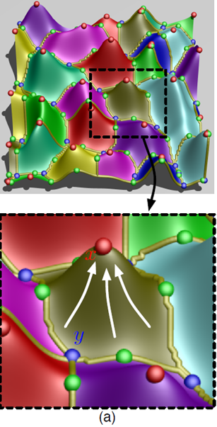
Computing the Morse Complex of a Smooth Function
For every point in domain:
Trace gradient until it becomes zero
Local Maximum
Saddle
Local Minimum

Slide 14

Approximating the Morse Complex on a Point Cloud
Connect points via a proximity graph (more on this later)
Local Maximum
Saddle
Local Minimum

Slide 15
Approximating the Morse Complex on a Point Cloud
Connect points via a proximity graph (more on this later)
For every point in sample set:
Estimate the gradient by following the steepest ascending edge until we reach a critical point with no ascending edges
Local Maximum
Saddle
Local Minimum

Slide 16
Definition of Persistence
Critical Points:
maxima =
minima =
3
p_{a}
# of Maxima
p_{b}
2
1
p_{a}
p_{b}
persistence
Notes:
A nice feature of the Morse-Smale complex is that we can associate a notion of feature scale. That is we can simplify or smooth away smaller features while maintaining the larger ones to arrive at a less resolved partitioning. This is done through a process known as persistence simplification.
Consider, this 1D function. Basically, we are going to pair neighboring critical points based on their smallest function value difference neighboring critical point (at the time of cancellation), and associate their function value difference as their combined persistence.
In this case, we first pair and cancel the small peak/valley combination on the left of this function.
Next, we pair the larger maximum and minimum together.
Lastly, we pair the local minimum and maximum occurring at the boundaries of the data. Note, that the last pair are not adjacent in the function, but since we have cancelled all of the other critical points they are now considered adjacent.

Slide 17
Definition of Persistence
Critical Points:
maxima =
minima =
3
p_{b}
# of Maxima
2
1
p_{a}
p_{b}
persistence
Notes:
A nice feature of the Morse-Smale complex is that we can associate a notion of feature scale. That is we can simplify or smooth away smaller features while maintaining the larger ones to arrive at a less resolved partitioning. This is done through a process known as persistence simplification.
Consider, this 1D function. Basically, we are going to pair neighboring critical points based on their smallest function value difference neighboring critical point (at the time of cancellation), and associate their function value difference as their combined persistence.
In this case, we first pair and cancel the small peak/valley combination on the left of this function.
Next, we pair the larger maximum and minimum together.
Lastly, we pair the local minimum and maximum occurring at the boundaries of the data. Note, that the last pair are not adjacent in the function, but since we have cancelled all of the other critical points they are now considered adjacent.

Slide 18
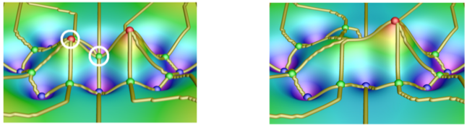
2D Persistence Simplification Example
Notes:
A nice feature of the Morse-Smale complex is that we can associate a notion of feature scale. That is we can simplify or smooth away smaller features while maintaining the larger ones to arrive at a less resolved partitioning. This is done through a process known as persistence simplification.
Consider, this 1D function. Basically, we are going to pair neighboring critical points based on their smallest function value difference neighboring critical point (at the time of cancellation), and associate their function value difference as their combined persistence.
In this case, we first pair and cancel the small peak/valley combination on the left of this function.
Next, we pair the larger maximum and minimum together.
Lastly, we pair the local minimum and maximum occurring at the boundaries of the data. Note, that the last pair are not adjacent in the function, but since we have cancelled all of the other critical points they are now considered adjacent.

Slide 19
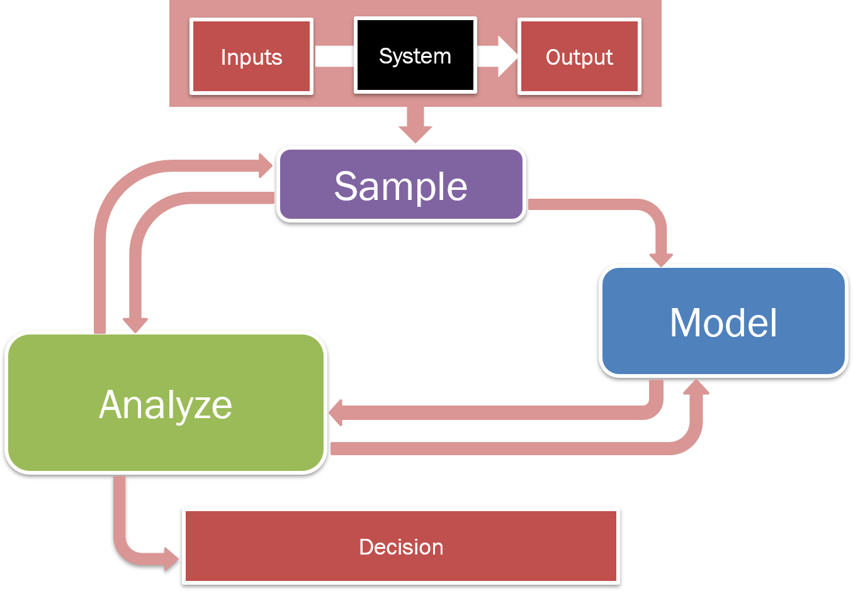
Sampling Contributions
Topology-based scoring
Limit surface adaptive sampling
Batch candidate selection
Notes:
Okay, so now with the necessary background in hand, we will begin by seeing how we can inject some of these concepts into the exploration phase.

Slide 20

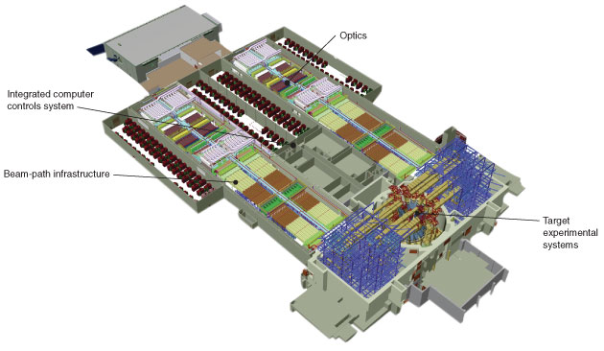
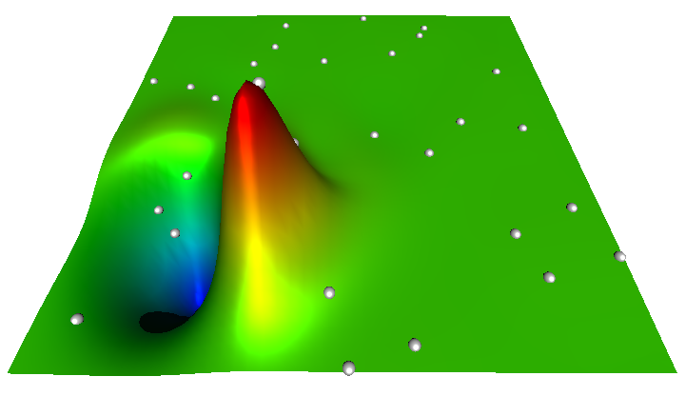
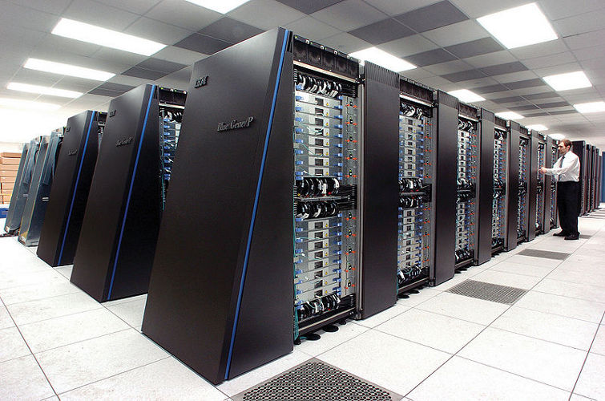
Why Adaptive Sampling?
Experiments are:
Dangerous
Expensive
Time-consuming
Multidimensional (up to 20 dimensions)
Exponential increase of volume as dimension increases
The domain is not equally informative
?
image courtesy of LLNL
Notes:
Given the nature of nuclear energy, it should come as no surprise that physical experimentation can be very dangerous, and so often we rely on computer simulations. However, due to the complexity of the physics we are modeling, collecting copious amounts of data can still be expensive and time-consuming. Therefore, it is to our advantage to extract the most amount of information from the least amount of data.
Furthermore, the input spaces we are interested can be of arbitrary input dimensionality, and from the curse of dimensionality we know that the space needed to sample grows exponentially with respect to increasing dimensionality. So, it is unlikely that we will ever recover a dense enough sampling in high-dimensions to do a meaningful global analysis.

Slide 21
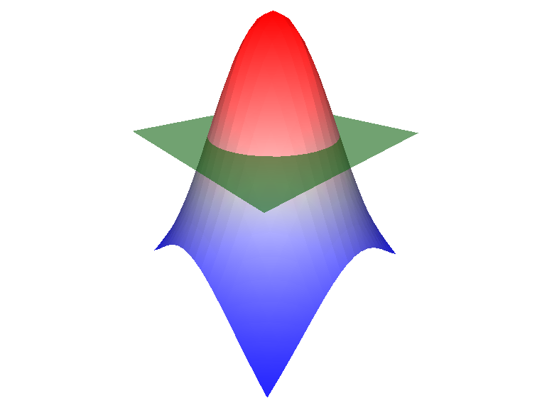
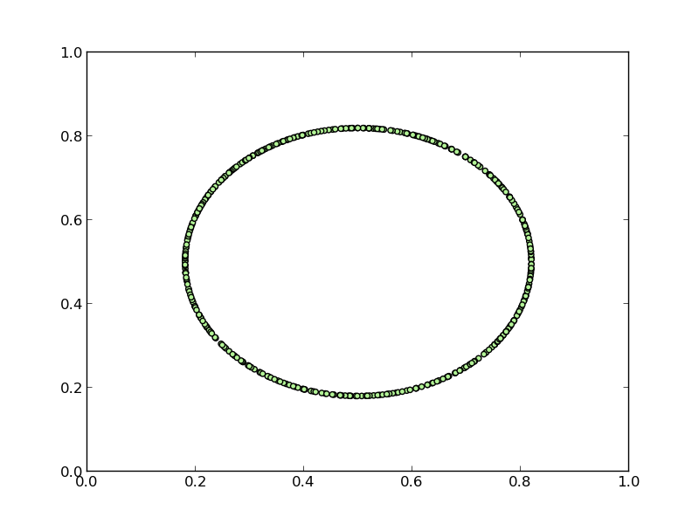
The Limit Surface Problem
Failure region
Limit surface
Notes:
Let me take a brief second to discuss a slightly different problem that nuclear engineers often deal with. Our last study, looked at adaptive sampling with the goal of obtaining a globally accurate fit of the data.
Often in the nuclear accident analysis, they are dealing with simulations where the goal is to understand the frontier that separates recoverable scenarios from system failure scenarios. The frontier we seek is known as the limit surface and the often the goal is to understand the probability of failure which amounts to determining the integral over the failure region.
In order to characterize the limit surface, they often rely on adaptive sampling methods.

Slide 22
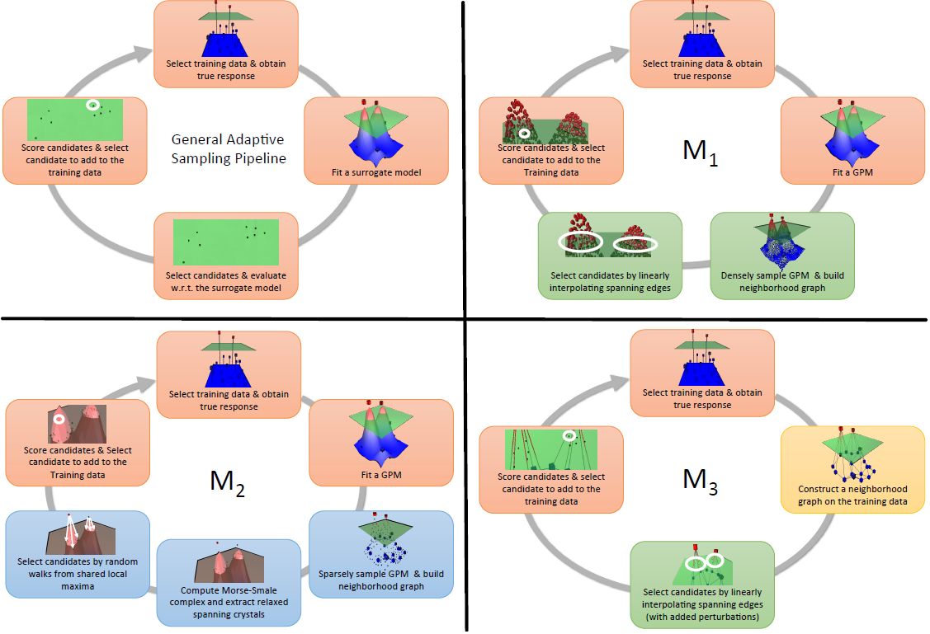
Cycles for Limit Surface Adaptive Sampling
Notes:
For the limit surface problem, we actually took a different approach and built three variations of the adaptive sampling pipeline from a prior slide. Two of these methods represent more exploitive models similar to what we have done before, and so in the interest of time, I will highlight what is referred to here as M2.

Slide 23
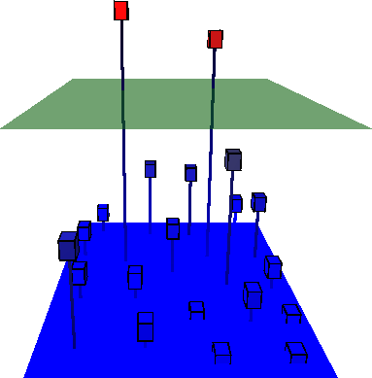
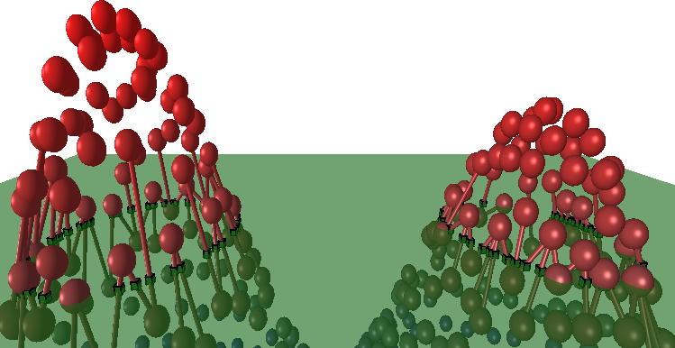
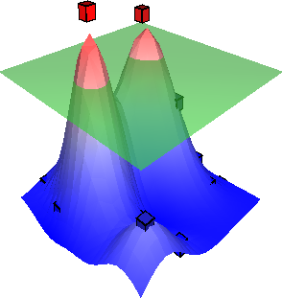
Generic Limit Surface Adaptive Sampling Lifecycle
Obtain true response
Select most informative candidate
Fit a surrogate model
Generate candidates

Slide 24
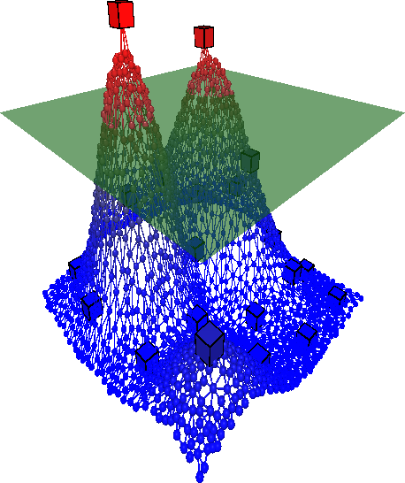
Variation 1: Exploit Predicting Model
Good for exploiting what the model currently knows
Can be biased by the model
Requires potentially large budget sampling of surrogate
Obtain true response
Select most informative candidate
Fit a surrogate model
Select candidates by linearly interpolating spanning edges
Sample surrogate & build proximity graph

Slide 25
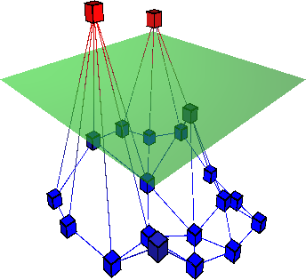
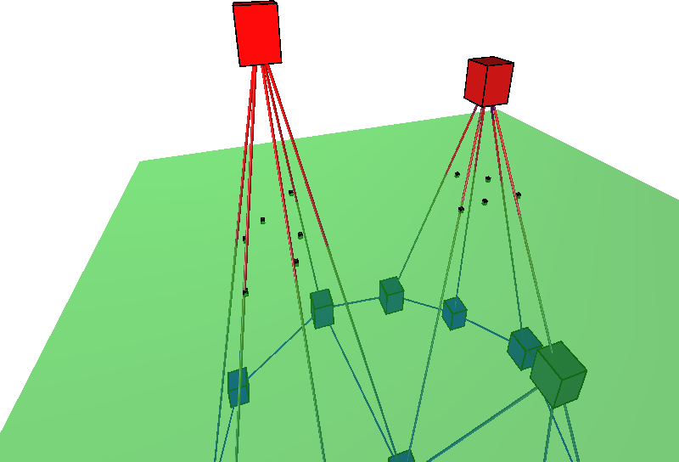
Variation 2: Linearized Graph Model
Good for exploiting what the model currently knows
Fast
Not much room of exploration
Obtain true response
Construct proximity graph on data
Select most informative candidate
Select candidates by linearly interpolating spanning edges (with added perturbations)

Slide 26
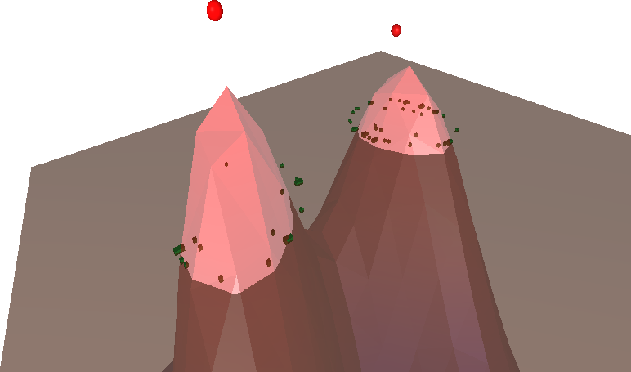
Variation 3: Relaxed Spanning Topology
Relaxation parameter can toggle between exploration and exploitation
Requires potentially large budget sampling of surrogate
Obtain true response
Select most informative candidate
Fit a surrogate model
Select candidates by random walks from shared local maxima
Sample surrogate & build neighborhood graph
Compute Morse complex and extract relaxed spanning cells

Slide 27
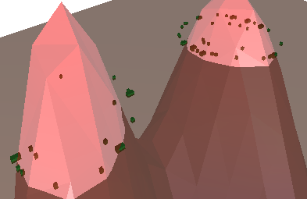
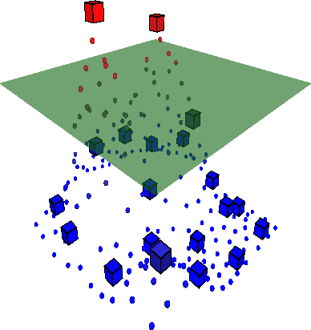
Variation 3: Relaxed Spanning Topology
Sample surrogate & build neighborhood graph

Slide 28
Variation 3: Relaxed Spanning Topology
Compute Morse complex and extract relaxed spanning cells

Slide 29
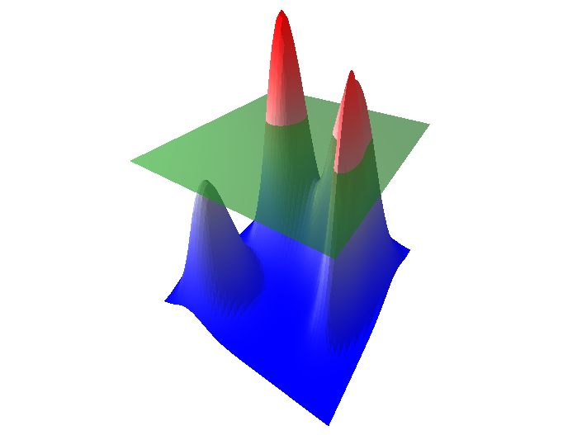
Variation 3: Relaxed Spanning Topology
Define a tolerance, or relax the “spanning” property of a cell

Slide 30
Variation 3: Relaxed Spanning Topology
Select candidates by random walks from shared local maxima

Slide 31
Variation 3: Relaxed Spanning Topology
s

Slide 32
Variation 3: Relaxed Spanning Topology
s

Slide 33
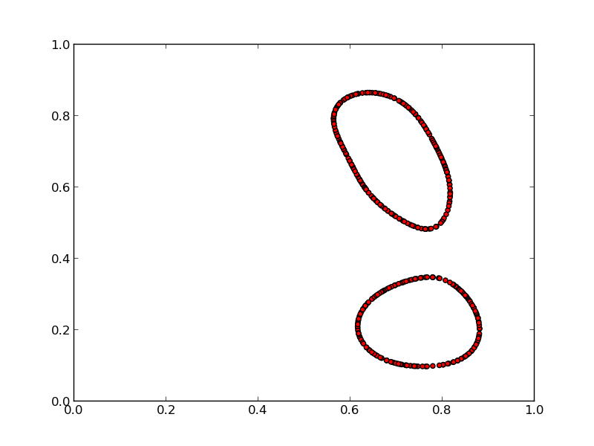
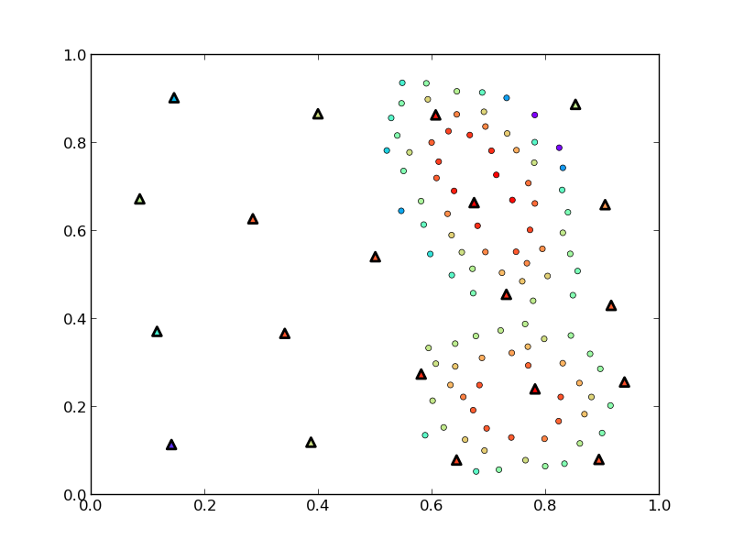
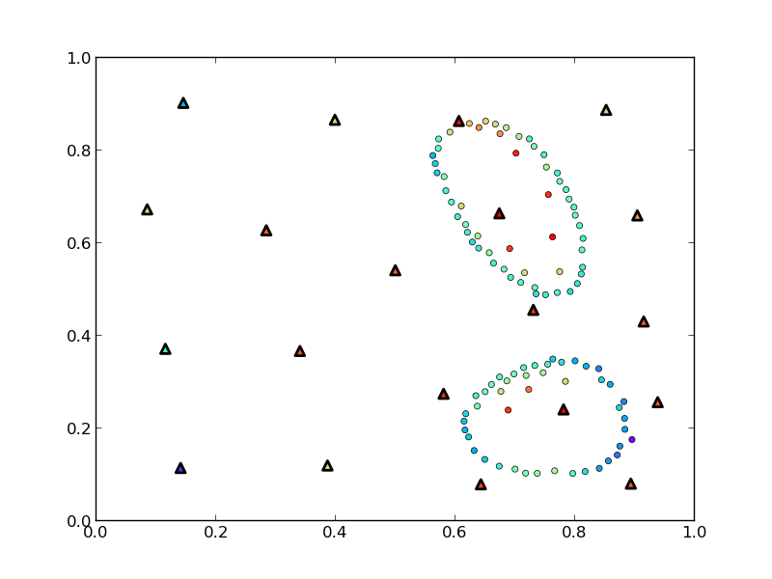
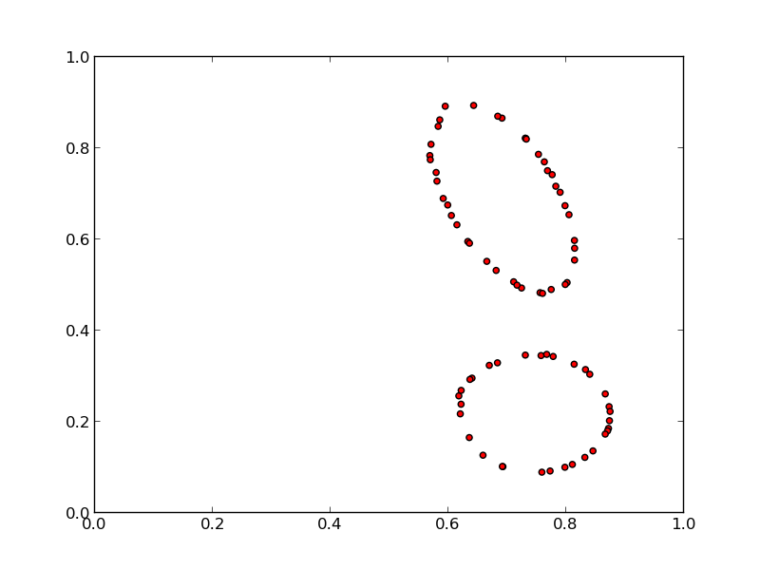
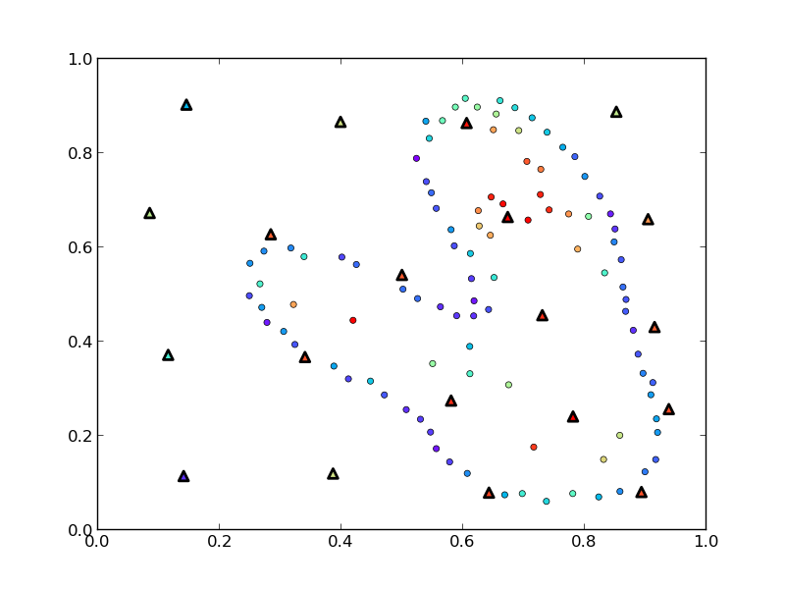
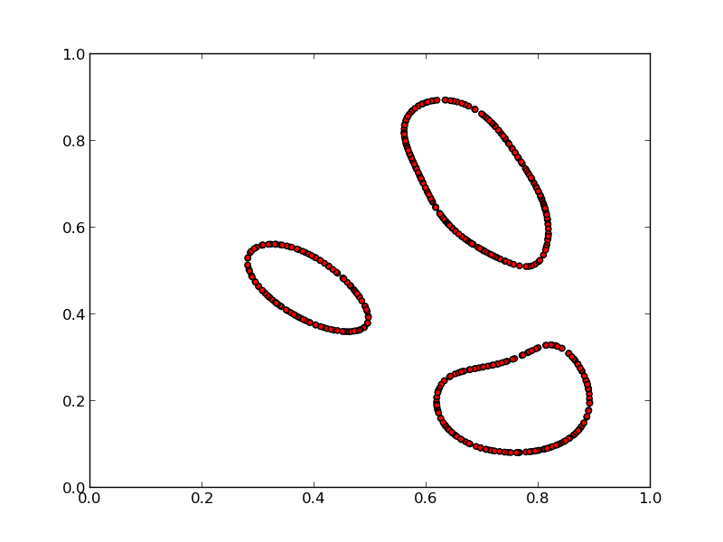
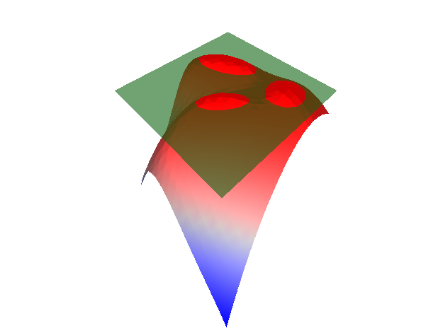
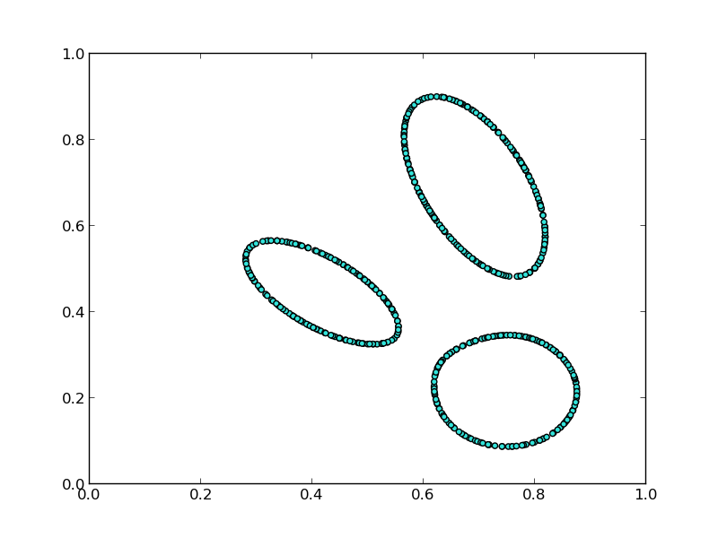
Topology Finds What Traditional Techniques Miss
Training Point (Ground Truth)
Selected Candidate
Limit Surface Sample
Explore vs. Exploit
1: Exploit Limit Surface of Predicting Model
2: Linearized Graph Model
3: Relaxed Spanning Topology
Adaptive Sampling Algorithms for Probabilistic Risk Assessment of Nuclear Simulations.
Dan Maljovec, Bei Wang, Diego Mandelli, Peer-Timo Bremer, and Valerio Pascucci. International Topical Meeting on Probabilistic Safety Assessment and Analysis (PSA), 2013.
*First Runner-up for Best Student Paper Award
True Limit Surface
Notes:
We see that with the appropriate relaxation setting, this model is actually able to identify a component of the true limit surface that was not captured in the initial training data.
This work was presented in a nuclear engineering conference and was runner-up for the best student paper award.

Slide 34
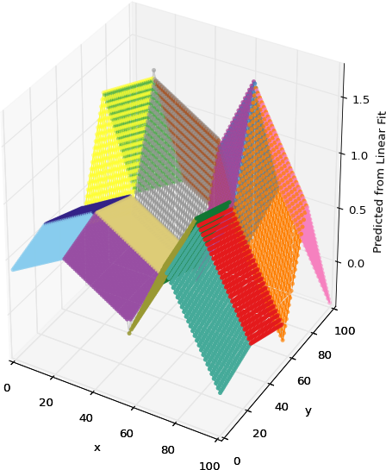




Analysis Contributions
Structured sensitivity analysis
Understanding approximation errors/limitations of topology
Various applications: nuclear safety, civil engineering, nuclear fusion research
Notes:
We now move on to discuss work being performed in the analysis phase.

Slide 35

Nuclear Fuel Problem Statement
Hydrostatic pressure
Thermal expansion
Fission gas swelling
Power scaling
Contact point (local maximum)
Equilibrium point (local minimum)
Cracking point (global maximum)
What drives the stress?
Notes:
Here, we investigate the problem of designing safer nuclear fuels. So, we investigate a simulation that looks at understanding the maximum stress occurring in the shielding that surrounds a nuclear fuel rod undergoing normal operation.
There are several different parameters of the fuel rod that interact with this stress in the system, and the scientists were interested in studying what drives the stress by performing sensitivity analysis, however we identified this problem as being ill-suited for a global sensitivity study due to the non-monotonic nature of the input. So, we needed to develop a method that was more amenable to this situation.

Slide 36




Previous Work of Sensitivity Analysis in Visualization
Global SA
Structured SA
Local SA
Decompose the domain into meaningful subsets
Apply global analysis on subsets
Summary metrics over entire data
First step for further exploration
Sensitivity centered around focal point
Drilldown tasks
Muhlbacher and Piringer 2013
Crossno et al. 2015
Struggles with non-monotonicity
Berger et al. 2011
Assumes we know the region of interest
Gerber et al. 2011
Notes:
So, typically the first go-to is a global sensitivity study and we have seen methods in visualization that do this for arbitrary input dimensions. These methods are great for parameter screening, however these types of methods struggle on non-monotonic data unless higher order methods are used, but these lack the direct interpretability of simple partial derivative type information.
On the other hand, local sensitivity analysis looks at a user-defined focal point giving a much more local and on-demand view of the information. These methods are better suited for drilldown techniques such as when one has identfied an area of interest or in optimization settings.
In terms of structured sensitivity, there has been past work, but these rely on 1 or 2D axis-aligned cuts of the data. The exception being the use of the Morse-Smale complex by Sam Gerber et al. which is where we want to focus our attention.
Here, I am highlighting the 2011 work that developed this software called HDViz. I utilized this technique in some of my earlier analysis with nuclear engineers, however after several iterations the nuclear engineers still relied heavily on expert users of the system, and so the idea of this work was to develop something intuitive and usable by the domain scientists directly.

Slide 37








New Intuitive Visualization Design
f(x)
?
persistence
Notes:
The second contribution of our paper was to design a system that was readily usable to our engineering counterparts without a steep learning curve. Existing tools that provide a similar analysis of the data are content-rich to the point of overwhelming the user with information, so we set out to design a set of views each with distinct tasks in mind, so as to avoid sensory overload and instead provide the succinct summaries of the data that the engineers seek.

Slide 38


SA Anomaly in Nuclear Fuel Simulations
?
Sign of thermal expansion coefficient sensitivity is reversed to the expected result
Rethinking Sensitivity Analysis of Nuclear Simulations with Topology.
Dan Maljovec, Bei Wang, Paul Rosen, Andrea Alfonsi, Giovanni Pastore, Cristian Rabiti, and Valerio Pascucci. Proceedings of IEEE Pacific Visualization (PacificVis), 2016.
Conclusion: Simulation input is incorrectly coded.
Notes:
So, the engineers used this tool to analyze the nuclear fuel data from before, and within 10 minutes, they were able to select an appropriate partition level and identified an anomaly in the data with respect to their expectation. The sign of one of the parameters was actually inverse of what they had expected, and so, we looked more closely at one of the simulations and noted that there was an error in the input deck that we were perturbing in order to generate this dataset.
It is important to note that in this process we cycled through an entire iteration of the experimental design process where we were able to identify an error and correct. For the sake of time, I am going to omit the corrected analysis on this data.

Slide 39

Morse-Smale Approximation Errors
The extracted topology depends on the graph
High
Low
Notes:
When evaluating this data, it is important to not that we are using an approximation of the Morse-Smale complex dependent on the amount of data we have. That is, we approximate gradient flow based on a neighborhood graph imposed on the data.

Slide 40
Morse-Smale Approximation Errors
The extracted topology depends on the graph
High
Extraneous extremum
Low
Notes:
This can lead to one of two problems in the approximation. The first is the result of having too few edges in the data. In the extreme case, this will create islands of data that are disjoint and unable to be analyzed, however the more common case results in spurious extrema as shown here.
In many cases, we can alleviate this problem with persistence simplifcation, but only if the feature scale is small.

Slide 41
Morse-Smale Approximation Errors
The extracted topology depends on the graph
High
Missed extremum
Low
Notes:
The other case results from an over-connected graph which completely misses the existence of extrema by edges that basically "skip over" saddle locations.
We performed several empirical tests on 2-5D test cases which were compiled into a Workshop paper in 2013.

Slide 42
Persistence Alone Is Not Enough
This happens in real-world datasets
Rethinking Sensitivity Analysis of Nuclear Simulations with Topology.
Dan Maljovec, Bei Wang, Paul Rosen, Andrea Alfonsi, Giovanni Pastore, Cristian Rabiti, and Valerio Pascucci. Proceedings of IEEE Pacific Visualization (PacificVis), 2016.
A Comparative Study of Morse Complex Approximation Using Different Neighborhood Graphs. Dan Maljovec, Avishek Saha, Peter Lindstrom, Peer-Timo Bremer, Bei Wang, Carlos Correa, and Valerio Pascucci. Topology-Based Methods in Visualization (TopoInVis), 2013.
Watershed-Scale Life Cycle Assessment Of Rainwater Harvesting Systems to Control Combined Sewer Overflows.
Hassan Tavakol-Davani, PhD Thesis. University of Utah, 2016.
Contact Point
Equilibrium Point
Notes:
In two different real world datasets, one of which we have seen already, the domain scientists discovered partitions they did not expect, and upon closer inspection appeared to be the result of poor sampling density in the regions of interest.
In this way, persistence simplification alone is unable to remove such features from the data.
One avenue of proposed work yet to be completed is to call attention to such problems and rely on a more user-guided interaction of the topology that allows them to explore certain branches of the hierarchy in exclusion and augment them manually if necessary.
In addition, I would like to explore the idea of further decomposing the monotonic patches of the Morse-Smale complex since monotonicity does not ensure an accurate linear fit.

Slide 43




Model Contributions
Introduction of p parameter for β^{p}-Skeleton graph
Approximation of cone graphs for efficient computation in multidimensional spaces
Problem decomposition allowing for scalable, parallel algorithm for β^{p}-skeletons and cone graphs amenable to the GPU
Developed quality measures of proximity graphs for three applications:
Topological computation
Shape reconstruction
SVM classification
Expensive
Good Structure
Cheap
Bad Structure
Cheap
Good Structure
Notes:
We now move on to discuss work being performed in the analysis phase.

Slide 44



What makes a “good” graph?
For Extracting Topology and many other tasks:
Limit directional bias
Respect shape of the manifold
Avoid large gaps
Avoid contradictory information
Notes:
We start this work with asking the question, what kinds of graphs are currently out there?
When this algorithm was first introduced we used the undirected kNN graph. In this case, I have set k=4, and what we then will do is connect each point to its 4 nearest neighbors in terms of Euclidean distance. Note, that some points have more than 4 edges, this is because we construct an undirected kNN graph, so even though b is not one of the 4 nearest neighbors of a because a is one of the 4 nearest neighbors of b, the edge exists. In practice, setting this k parameter can be difficult because depending on the density of your samples and the dimensionality in which your samples exist, you will want to use more or fewer neighbors.

Slide 45
What Graphs Can We Use?
k-Nearest Neighborhood
k is sensitive to dimensionality and density of points
May not be a universally good k
Sampling can bias in one direction
Can be useful for extracting embedded manifolds
Edge ab exists if a is one of the k closest neighbors to b or b is one of the k closest neighbors of a
k=4
Notes:
We start this work with asking the question, what kinds of graphs are currently out there?
When this algorithm was first introduced we used the undirected kNN graph. In this case, I have set k=4, and what we then will do is connect each point to its 4 nearest neighbors in terms of Euclidean distance. Note, that some points have more than 4 edges, this is because we construct an undirected kNN graph, so even though b is not one of the 4 nearest neighbors of a because a is one of the 4 nearest neighbors of b, the edge exists. In practice, setting this k parameter can be difficult because depending on the density of your samples and the dimensionality in which your samples exist, you will want to use more or fewer neighbors.

Slide 46
What Graphs Can We Use?
k-Nearest Neighborhood
β-Skeletons
β<1
Edge ab exists if no other points lie in a region R circumscribing ab.
R is the intersection of all L₂-norm balls with a and b on the boundary and whose radius r is defined by:
r = ||ab||₂ / 2β
a
b

Slide 47
What Graphs Can We Use?
k-Nearest Neighborhood
β-Skeletons
β<1
β=1 (Gabriel Graph)
Edge ab exists if no other points lie in a region R circumscribing ab.
R is the intersection of all L₂-norm balls with a and b on the boundary and whose radius r is defined by:
r = ||ab||₂ / 2β
Edge ab exists if no other points lie in a region R circumscribing ab.
R is the intersection of two congruent L₂-norm balls whose centers lie on the line coincident with ab and a or b lies on the boundary:
r = ||ab||₂ β / 2
a
b
Notes:
We can see, as we grow the beta parameter, we increase the size of the empty region. The special case of beta = 1, is known as the Gabriel graph and we can see that it's empty region is just the circumcircle of the edge.

Slide 48
What Graphs Can We Use?
k-Nearest Neighborhood
β-Skeletons
β<1
β=1 (Gabriel Graph)
1<β<2
β=2 (Relative Neighbor Graph)
Edge ab exists if no other points lie in a region R circumscribing ab.
R is the intersection of two congruent L₂-norm balls whose centers lie on the line coincident with ab and a or b lies on the boundary:
r = ||ab||₂ β / 2
a
b
*Increasing β,
Decreases edge density
Notes:
We can continue to grow the empty region until we arrive at the case where beta = 2 which gives us another special graph called the
relative neighbor graph. The take away here is that increasing beta, decreases the number of edges in our graph. In their work, Peter and Carlos noted that we can relax this strict definition and they claim without drastically changing the underlying graph.

Slide 49
What Graphs Can We Use?
k-Nearest Neighborhood
β-Skeletons
β<1
β=1 (Gabriel Graph)
1<β<2
β=2 (Relative Neighbor Graph)
Relaxed β-Skeletons
c
b
a
Notes:
This relaxation to the empty region property is that we apply it to only points that are neighbors to both p and q. Take the example shown here. We want to attempt to connect the a and b, but the point c lies within the empty region of edge ab. However, c is not a neighbor of a, so we can still add this edge based on our relaxed condition.

Slide 50
What Graphs Can We Use?
k-Nearest Neighborhood
β-Skeletons
β<1
β=1 (Gabriel Graph)
1<β<2
β=2 (Relative Neighbor Graph)
Relaxed β-Skeletons
Cone Graphs
m-Yao Graph
Divide the hypersphere surrounding point a into c equal sized cones. Connect a to its m closest neighbors in each cone.
c=4, m=1
Notes:
So, this was the state of the art when I started working on this problem. This led me to a few different questions, one is can we more generically describe these empty regions, and two are there other representations in the literature that do something similar. That is, if we examine why the beta skeleton works well, we note that it is able to more evenly sample the space of directions surrounding a point. Now, mind you this is operating under that our input space is dense in the sense that the "manifold" is the entire space, but I can elaborate more on that if you want later.
So, after poking around, I stumbled on these graphs known as cone-based spanners, where the idea is to break up the directions surrounding a query point into equal-sized cones and connect the point to a neighbor in each cone. There are two versions that are only slight modifications of one another, the first is the m-Yao graph. Here m is a free parameter stating how many points we will draw from each cone. The Yao graph is going to simply add an edge to the m closest points in each cone.

Slide 51
What Graphs Can We Use?
k-Nearest Neighborhood
β-Skeletons
β<1
β=1 (Gabriel Graph)
1<β<2
β=2 (Relative Neighbor Graph)
Relaxed β-Skeletons
Cone Graphs
m-Yao Graph
m-Θ Graph
Divide the hypersphere surrounding point a into c equal sized cones. Connect a to its m closest projected neighbors onto the cone axis for each cone.
c=4, m=1
Notes:
The m-Theta graph rather than taking the closest distance, will project the points onto the axis of the cone and take the closest projected distance. Note, how this changes this example here.

Slide 52
β_{p}-Skeletons – Changing the Shape of the Empty Region
Testing ERG of PQ on R:
Parameterize the problem:
R
P
Q

Slide 53
β_{p}-Skeletons – Changing the Shape of the Empty Region
Testing ERG of PQ on R:
Parameterize the problem:
t = <PR,PQ>
If t < 0 or t > 1
then no intersection
R
P
Q
t

Slide 54
β_{p}-Skeletons – Changing the Shape of the Empty Region
Testing ERG of PQ on R:
Parameterize the problem:
t = <PR,PQ>
If t < 0 or t > 1
then no intersection
Compute L₂-distance from point to edge:
If d₂(R,PQ) <= m(t)
then intersection
R
d₂(R,PQ)
m(t)
P
Q
t

Slide 55
β_{p}-Skeletons – Changing the Shape of the Empty Region
Testing ERG of PQ on R:
Parameterize the problem:
t = <PR,PQ>
If t < 0 or t > 1
then no intersection
Compute L₂-distance from point to edge:
If d₂(R,PQ) <= m(t)
then intersection
We can change the size of m(t) by changing β
We can change the shape of m(t)by changing the L_{p}-norm
R
β>1
p=1
β=1
p=∞
p<1
β<1
P
Q
t

Slide 56
β_{p}-Skeletons – Changing the Shape of the Empty Region
Testing ERG of PQ on R:
Parameterize the problem:
t = <PR,PQ>
If t < 0 or t > 1
then no intersection
Compute L₂-distance from point to edge:
If d₂(R,PQ) <= m(t)
then intersection
We can change the size of m(t) by changing β
We can change the shape of m(t)by changing the L_{p}-norm
We can discretize and precompute m(t)
Scale by edge length at runtime
R
P
Q
t
Allows construction of arbitrary radially and reflectively symmetric shapes

Slide 57
Discrete β_{p}-Skeleton: Even more Shapes!

Slide 58

Approximating Equal Cones in High Dimension using CCVT
How do you generate a set of equally-spaced cones in high dimension?
Observation: We only need the axis of the cones
Maximum cosine similarity between vector and cone axis yields membership
Approximate Centroidal Voronoi Tessellation (CVT)
An algorithm for giving points that have a nice blue noise property
A Voronoi tessellation where the sites = centers of mass for each region
Can be constrained to the surface of a hypersphere: Constrained CVT (CCVT)

Slide 59
Approximating Equal Cones in High Dimension using CCVT
How do you generate a set of equally-spaced cones in high dimension?
Observation: We only need the axis of the cones
Maximum cosine similarity between vector and cone axis yields membership
Approximate Centroidal Voronoi Tessellation (CVT)
An algorithm for giving points that have a nice blue noise property
A Voronoi tessellation where the sites = centers of mass for each region
Can be constrained to the surface of a hypersphere: Constrained CVT (CCVT)

Slide 60
Approximating Equal Cones in High Dimension using CCVT
How do you generate a set of equally-spaced cones in high dimension?
Observation: We only need the axis of the cones
Maximum cosine similarity between vector and cone axis yields membership
Approximate Centroidal Voronoi Tessellation (CVT)
An algorithm for giving points that have a nice blue noise property
A Voronoi tessellation where the sites = centers of mass for each region
Can be constrained to the surface of a hypersphere: Constrained CVT (CCVT)

Slide 61


GPU Performance Gains
Requires neighbors’ neighbors per edge test
Strict Gabriel Graph
Requires only neighbors per edge test
Relaxed Gabriel Graph
Yao Graph

Slide 62







Evaluating Topological Correctness
Family of Morse Complexes
True Morse Complex
High
persistence
Low
Test Function
Is the true solution part of this family?
Can I reliably expect to find it?
≈
persistence
Notes:
So, here is our well-defined function where we can come up with ground-truth labels quite easily by slicing the domain with these hyperplanes that are perpendicular to the main diagonal. By the way, this example is a four dimensional input case.
Mind you, what we have done is run several cases of different parameters for each graph and selected the optimal-performing graph for each family and show the results for just that graph here.
There are two plots we are showing here, the first is what is known as the Normalized variation of information. Note, here that lower values are more in agreement with the ground truth. This is mostly done as a sanity check to ensure that our stable convergence is not to the wrong segmentation, which in the case of the theta graph could be the case.
The more interesting graph here is the bottom graph where I am showing that as we increase the size of our sample set, what is the stability or width of the "correct" bar from the previous slide.
The point I want to make here is that in many of the tests we performed, the Yao graph was either as good as or sometimes better than the strict Gabriel graph, and in many cases the strict graph is much better than the relaxed version.
This is important because the last plot on performance should indicate to you that the strict beta skeletons are much slower to compute, and so if we can use the Yao graph to get similar fidelity while maintaining the speed of the relaxed beta skeleton, we may want to consider the Yao as a good alternative in practice. The one caveat is that it can sometimes be harder to tune the Yao graph parameters when compared to the beta skeletons when working in arbitrary dimensional spaces.

Slide 63



Yao Graphs are Competitive (and Performant)
Is my solution part of this family?
Can I reliably expect to find it?
High
4D Example
Parameters optimized
Low
Test Function
Notes:
So, here is our well-defined function where we can come up with ground-truth labels quite easily by slicing the domain with these hyperplanes that are perpendicular to the main diagonal. By the way, this example is a four dimensional input case.
Mind you, what we have done is run several cases of different parameters for each graph and selected the optimal-performing graph for each family and show the results for just that graph here.
There are two plots we are showing here, the first is what is known as the Normalized variation of information. Note, here that lower values are more in agreement with the ground truth. This is mostly done as a sanity check to ensure that our stable convergence is not to the wrong segmentation, which in the case of the theta graph could be the case.
The more interesting graph here is the bottom graph where I am showing that as we increase the size of our sample set, what is the stability or width of the "correct" bar from the previous slide.
The point I want to make here is that in many of the tests we performed, the Yao graph was either as good as or sometimes better than the strict Gabriel graph, and in many cases the strict graph is much better than the relaxed version.
This is important because the last plot on performance should indicate to you that the strict beta skeletons are much slower to compute, and so if we can use the Yao graph to get similar fidelity while maintaining the speed of the relaxed beta skeleton, we may want to consider the Yao as a good alternative in practice. The one caveat is that it can sometimes be harder to tune the Yao graph parameters when compared to the beta skeletons when working in arbitrary dimensional spaces.

Slide 64

Input Parameter Candidates
+ Target Output(s)
Sample
Utilizing topology to explore new regions in adaptive sampling
Development of structured sensitivity analysis framework
Better understanding of limitations of topology
New graph representations
More efficient data structures
Systematic evaluation strategies for graph models
Model
Analyze
Decision
Notes:
So, scientific research at its most basic level is about observing phenomena occuring in nature and our surroundings through relationships of different quantities of interest. For our purposes, we are interested in studying the relationship between some input parameters that we have direct control over and observable target outputs, we believe to be correlated to a subset of those inputs. We perform our experimental design and the end result is some enhanced approximation or theory about the relationship.
We are interested in what is happening in this middle box, so if we lift the covers and look a bit more closely we see three major componenets of the experimental design process: Explore, Analyze, and Synthesize.

Slide 65
BACKUPS

Slide 66









Yao Graphs are Competitive (and Performant)

Slide 67








Yao Graphs are Competitive (and Performant)

Slide 68



Approximation Does Not Degrade with Increasing Dimensionality
However it does appear to be affected by an increase in the number of cones

Slide 69
Handling Large Graphs by Batching the GPU Computation
X = n⨯d (floating point location data)
E = n⨯k (integer indices representing k-nn supergraph)
Let:
n = 10
d = 2
k = 4
q = 2
7
3
6
5
8
1
2
4
9
0

Slide 70

Handling Large Graphs by Batching the GPU Computation
X = n⨯d (floating point location data)
E = n⨯k (integer indices representing k-nn supergraph)
Let:
n = 10
d = 2
k = 4
q = 2
X
E
0
1
2
3
4
5
6
7
8
9
0
1
2
3
4
5
6
7
8
9
4 2 9 1
5 2 4 8
4 1 5 0
6 7 2 4
2 0 6 1
1 8 2 4
3 7 4 2
3 6 1 5
5 1 9 2
0 8 1 2

Slide 71
Handling Large Graphs by Batching the GPU Computation
X = n⨯d (floating point location data)
E = n⨯k (integer indices representing k-nn supergraph)
Let:
n = 10
d = 2
k = 4
q = 2
X
E
Map
0
1
2
3
4
5
6
7
8
9
0
1
2
3
4
5
6
7
8
9
4 2 9 1
5 2 4 8
0 0
1 1
2 2
4 3
5 4
8 5
9 6

Slide 72
Handling Large Graphs by Batching the GPU Computation
X = n⨯d (floating point location data)
E = n⨯k (integer indices representing k-nn supergraph)
Let:
n = 10
d = 2
k = 4
q = 2
X
E
Map
0
1
2
3
4
5
6
7
8
9
0
1
2
3
4
5
6
7
8
9
3 2 6 1
4 2 3 5
0 0
1 1
2 2
4 3
5 4
8 5
9 6

Slide 73
Handling Large Graphs by Batching the GPU Computation
X = n⨯d (floating point location data)
E = n⨯k (integer indices representing k-nn supergraph)
Let:
n = 10
d = 2
k = 4
q = 2
X
E
Map
0
1
2
3
4
5
6
7
8
9
0
1
2
3
4
5
6
7
8
9
3 2 6 _
4 2 _ _
0 0
1 1
2 2
4 3
5 4
8 5
9 6

Slide 74
Handling Large Graphs by Batching the GPU Computation
X = n⨯d (floating point location data)
E = n⨯k (integer indices representing k-nn supergraph)
Let:
n = 10
d = 2
k = 4
q = 2
X
E
Map
0
1
2
3
4
5
6
7
8
9
0
1
2
3
4
5
6
7
8
9
4 2 9 _
5 2 _ _
0 0
1 1
2 2
4 3
5 4
8 5
9 6

Slide 75
Full Relaxed β_{p}-Skeleton Batching Algorithm
X = n⨯d (floating point location data)
E = n⨯k (integer indices representing k-nn supergraph)
Let:
n = 10
d = 2
k = 4
q = 2
X
E
Map
0
1
2
3
4
5
6
7
8
9
0
1
2
3
4
5
6
7
8
9
4 2 9 _
5 2 _ _
4 1 5 0
6 7 2 4
2 0
3 1
0 2
1 3
4 4
5 5
6 6
7 7

Slide 76
Full Relaxed β_{p}-Skeleton Batching Algorithm
X = n⨯d (floating point location data)
E = n⨯k (integer indices representing k-nn supergraph)
Let:
n = 10
d = 2
k = 4
q = 2
X
E
Map
0
1
2
3
4
5
6
7
8
9
0
1
2
3
4
5
6
7
8
9
4 2 9 _
5 2 _ _
4 3 5 2
6 7 0 4
2 0
3 1
0 2
1 3
4 4
5 5
6 6
7 7

Slide 77
Full Relaxed β_{p}-Skeleton Batching Algorithm
X = n⨯d (floating point location data)
E = n⨯k (integer indices representing k-nn supergraph)
Let:
n = 10
d = 2
k = 4
q = 2
X
E
Map
0
1
2
3
4
5
6
7
8
9
0
1
2
3
4
5
6
7
8
9
4 2 9 _
5 2 _ _
4 3 _ 2
6 7 0 _
2 0
3 1
0 2
1 3
4 4
5 5
6 6
7 7

Slide 78
Full Relaxed β_{p}-Skeleton Batching Algorithm
X = n⨯d (floating point location data)
E = n⨯k (integer indices representing k-nn supergraph)
Let:
n = 10
d = 2
k = 4
q = 2
X
E
Map
0
1
2
3
4
5
6
7
8
9
0
1
2
3
4
5
6
7
8
9
4 2 9 _
5 2 _ _
4 1 _ 0
6 7 2 _
2 0
3 1
0 2
1 3
4 4
5 5
6 6
7 7

Slide 79
Full Relaxed β_{p}-Skeleton Batching Algorithm
X = n⨯d (floating point location data)
E = n⨯k (integer indices representing k-nn supergraph)
Let:
n = 10
d = 2
k = 4
q = 2
X
E
Map
0
1
2
3
4
5
6
7
8
9
0
1
2
3
4
5
6
7
8
9
4 2 9 _
5 2 _ _
4 1 _ 0
6 7 2 _
2 0 6 1
1 8 2 4
4 0
5 1
0 2
1 3
2 4
6 5
8 6

Slide 80
Full Relaxed β_{p}-Skeleton Batching Algorithm
X = n⨯d (floating point location data)
E = n⨯k (integer indices representing k-nn supergraph)
Let:
n = 10
d = 2
k = 4
q = 2
X
E
Map
0
1
2
3
4
5
6
7
8
9
0
1
2
3
4
5
6
7
8
9
4 2 9 _
5 2 _ _
4 1 _ 0
6 7 2 _
4 2 5 3
3 6 4 0
4 0
5 1
0 2
1 3
2 4
6 5
8 6

Slide 81
Full Relaxed β_{p}-Skeleton Batching Algorithm
X = n⨯d (floating point location data)
E = n⨯k (integer indices representing k-nn supergraph)
Let:
n = 10
d = 2
k = 4
q = 2
X
E
Map
0
1
2
3
4
5
6
7
8
9
0
1
2
3
4
5
6
7
8
9
4 2 9 _
5 2 _ _
4 1 _ 0
6 7 2 _
4 2 5 _
3 6 _ _
4 0
5 1
0 2
1 3
2 4
6 5
8 6

Slide 82
Full Relaxed β_{p}-Skeleton Batching Algorithm
X = n⨯d (floating point location data)
E = n⨯k (integer indices representing k-nn supergraph)
Let:
n = 10
d = 2
k = 4
q = 2
X
E
Map
0
1
2
3
4
5
6
7
8
9
0
1
2
3
4
5
6
7
8
9
4 2 9 _
5 2 _ _
4 1 _ 0
6 7 2 _
2 0 6 _
1 8 _ _
4 0
5 1
0 2
1 3
2 4
6 5
8 6

Slide 83
Full Relaxed β_{p}-Skeleton Batching Algorithm
X = n⨯d (floating point location data)
E = n⨯k (integer indices representing k-nn supergraph)
Let:
n = 10
d = 2
k = 4
q = 2
X
E
Map
0
1
2
3
4
5
6
7
8
9
0
1
2
3
4
5
6
7
8
9
4 2 9 _
5 2 _ _
4 1 _ 0
6 7 2 _
2 0 6 _
1 8 _ _
3 7 4 2
3 6 1 5
6 0
7 1
1 2
2 3
3 4
4 5
5 6

Slide 84
Full Relaxed β_{p}-Skeleton Batching Algorithm
X = n⨯d (floating point location data)
E = n⨯k (integer indices representing k-nn supergraph)
Let:
n = 10
d = 2
k = 4
q = 2
X
E
Map
0
1
2
3
4
5
6
7
8
9
0
1
2
3
4
5
6
7
8
9
4 2 9 _
5 2 _ _
4 1 _ 0
6 7 2 _
2 0 6 _
1 8 _ _
4 1 5 3
4 0 2 6
6 0
7 1
1 2
2 3
3 4
4 5
5 6

Slide 85
Full Relaxed β_{p}-Skeleton Batching Algorithm
X = n⨯d (floating point location data)
E = n⨯k (integer indices representing k-nn supergraph)
Let:
n = 10
d = 2
k = 4
q = 2
X
E
Map
0
1
2
3
4
5
6
7
8
9
0
1
2
3
4
5
6
7
8
9
4 2 9 _
5 2 _ _
4 1 _ 0
6 7 2 _
2 0 6 _
1 8 _ _
4 _ 5 _
4 _ _ 6
6 0
7 1
1 2
2 3
3 4
4 5
5 6

Slide 86
Full Relaxed β_{p}-Skeleton Batching Algorithm
X = n⨯d (floating point location data)
E = n⨯k (integer indices representing k-nn supergraph)
Let:
n = 10
d = 2
k = 4
q = 2
X
E
Map
0
1
2
3
4
5
6
7
8
9
0
1
2
3
4
5
6
7
8
9
4 2 9 _
5 2 _ _
4 1 _ 0
6 7 2 _
2 0 6 _
1 8 _ _
3 _ 4 _
3 _ _ 5
6 0
7 1
1 2
2 3
3 4
4 5
5 6

Slide 87
Full Relaxed β_{p}-Skeleton Batching Algorithm
X = n⨯d (floating point location data)
E = n⨯k (integer indices representing k-nn supergraph)
Let:
n = 10
d = 2
k = 4
q = 2
X
E
Map
0
1
2
3
4
5
6
7
8
9
0
1
2
3
4
5
6
7
8
9
4 2 9 _
5 2 _ _
4 1 _ 0
6 7 2 _
2 0 6 _
1 8 _ _
3 _ 4 2
3 _ _ 5
5 1 9 2
0 8 1 2
8 0
9 1
0 2
1 3
2 4
5 5

Slide 88
Full Relaxed β_{p}-Skeleton Batching Algorithm
X = n⨯d (floating point location data)
E = n⨯k (integer indices representing k-nn supergraph)
Let:
n = 10
d = 2
k = 4
q = 2
X
E
Map
0
1
2
3
4
5
6
7
8
9
0
1
2
3
4
5
6
7
8
9
4 2 9 _
5 2 _ _
4 1 _ 0
6 7 2 _
2 0 6 _
1 8 _ _
3 _ 4 2
3 _ _ 5
5 3 1 4
2 0 3 4
8 0
9 1
0 2
1 3
2 4
5 5

Slide 89
Full Relaxed β_{p}-Skeleton Batching Algorithm
X = n⨯d (floating point location data)
E = n⨯k (integer indices representing k-nn supergraph)
Let:
n = 10
d = 2
k = 4
q = 2
X
E
Map
0
1
2
3
4
5
6
7
8
9
0
1
2
3
4
5
6
7
8
9
4 2 9 _
5 2 _ _
4 1 _ 0
6 7 2 _
2 0 6 _
1 8 _ _
3 _ 4 2
3 _ _ 5
5 _ 1 _
2 0 3 _
8 0
9 1
0 2
1 3
2 4
5 5

Slide 90
Full Relaxed β_{p}-Skeleton Batching Algorithm
X = n⨯d (floating point location data)
E = n⨯k (integer indices representing k-nn supergraph)
Let:
n = 10
d = 2
k = 4
q = 2
X
E
Map
0
1
2
3
4
5
6
7
8
9
0
1
2
3
4
5
6
7
8
9
4 2 9 _
5 2 _ _
4 1 _ 0
6 7 2 _
2 0 6 _
1 8 _ _
3 _ 4 2
3 _ _ 5
5 _ 9 _
0 8 1 _
8 0
9 1
0 2
1 3
2 4
5 5

Slide 91
Full Relaxed β_{p}-Skeleton Batching Algorithm
X = n⨯d (floating point location data)
E = n⨯k (integer indices representing k-nn supergraph)
Let:
n = 10
d = 2
k = 4
q = 2
X
E
0
1
2
3
4
5
6
7
8
9
0
1
2
3
4
5
6
7
8
9
4 2 9 1
5 2 4 8
4 1 5 0
6 7 2 4
2 0 6 1
1 8 2 4
3 7 4 2
3 6 1 5
5 1 9 2
0 8 1 2

Slide 92
Case Study: Classification Training Reduction
Looking at SVM Classifiers
The only points that matter in a SVM are the “support vectors”
Does not scale well as size of input data grows
Premise: Start with data that has a high probability of being on the boundary
(points with edges spanning the decision boundary)

Slide 93


Case Study: Classification Training Reduction

Slide 94
What Other Graphs Can We Use?
Delaunay Triangulation
Can create long edges on the boundary of domain
Number of points on the boundary increases with dimensionality
Curse of dimensionality

Slide 95

β_{p}-Skeleton Relative Area of Empty Region

Slide 96

Approximate KNN Graphs
Publicly available benchmark that evaluates 20+ ANN implementations
Not Realistic to our Application:
Benchmarks are highly sparse spaces
(d > 100, n ≈ 1M)
Represents optimal performance
Many runs, highly tuned, takes a long time to generate
Does not include build time
Our usage is much more transient

Slide 97

Approximate KNN Graphs
FLANN is using an exact KNN method.

Slide 98



Case Study 1: 2D Graph Quality
What makes a “good” graph?
Minimizes edge crossings
Bad for Morse topology
Minimize empty space
Captures all of the intrinsic “shape” of the data
Does not exceed the intrinsic “shape”
Captures the topology correctly

Slide 99









Case Study 1: 2D Graph Quality

Slide 100


Saturating the β_{p}-Skeleton

Slide 101
Measuring Accuracy using Information Theory
H(X)
Entropy – Uncertainty in X
H(X|Y)
Conditional Entropy – Given Y, uncertainty in X
H(X,Y)
Joint Entropy – Uncertainty in X,Y
Mutual Information – Given X, reduction in uncertainty in Y (or vice versa)
I(X,Y) = H(X) + H(Y) – H(X,Y)
Normalized Variation of Information
– Distance metric between partitions
NVI(X,Y) = 1 – (I(X,Y) / H(X,Y))
H(X)
H(Y)
H(X|Y)
I(X,Y)
H(Y|X)
H(X,Y)

Slide 102



Measuring Accuracy using Information Theory
NVI(X,Y) = 1, no correlation
NVI(X,Y) = 0, exact correlation
Normalized Variation of Information
– Distance metric between partitions
Ground truth labels = X
Experimental Labels = Y
NVI(X,Y) = 1 – (I(X,Y) / H(X,Y))

Slide 103




Changing the Adaptive Sampling Cycle
Training Point (Ground Truth Available)
Candidate Point
Run experiment at training location(s)
Fit a predicting model
Generate & score candidates
Select candidate for training

Slide 104


Comparing Scoring Methods
High uncertainty in the current predicting model
Expected improvement (steep gradient + uncertainty)
Topology-based scoring

Slide 105



Comparing Scoring Methods
High uncertainty in the current predicting model
Expected improvement (steep gradient + uncertainty)
Topology-based scoring
Global Topological Influence
Local Topological
Influence
Σ(Δp)/n
Adaptive Sampling with Topological Scores. Dan Maljovec, Bei Wang, Ana Kupresanin, Gardar Johannesson, Valerio Pascucci, and Peer-Timo Bremer. International Journal for Uncertainty Quantification, 3(2), pages 119-141, 2013

Slide 106





Exploiting Parallelism with Candidate Selection
Candidate selection
One-at-a-time
Batch selection
allows running several time-consuming experiments in parallel
Identifying distinct local peaks in the scoring landscape
Topology-Based Active Learning.
Dan Maljovec, Bei Wang, John Moeller, and Valerio Pascucci SCI Technical Report UUSCI-2014-00, 2014.
low score
high score
Training point
Candidate point
Adaptive point
Notes:
The last step of the general adaptive sampling pipeline is candidate selection. So far, we have assumed the context of selecting one point before refitting. Under parallel settings, though we can see the benefit of being able to execute several ground truth simulations at once especially since these can take hours or days to complete.
For this, we instead focused our attention on the topology of the scoring landscape rather than the topology of the predicting model. In this way, we can explore distinct topological peaks in the data.
This work is part of a tech report where we compared results in the low-dimensional setting for both global and limit surface problems.

Slide 107


Terminology
Manifold (𝕄)
Homeomorphic to ℝ^{n}
Morse Function (f)
No two critical points share the same function value
There are no degenerate critical points
x ∈ 𝕄, ∇f(x) = 0 → det(H_{f}(x)) ≠ 0
Integral Line (l(t))
A path whose tangent is parallel to the gradient everywhere
l′(t) = ∇f(l(t)), ∀t ∈ ℝ
high
f(x)
low
∇f(x)
l(t)
Notes:
To clarify, I want to define a few terms from the previous slide. A manifold is a space that locally resembles a Euclidean space of that dimensionality everywhere it is defined.
In addition, the target responses we are evaluating will be treated as smooth functions defined over the manifolds. This means at any location in the input manifold, the target and its derivative are continuously defined.

Slide 108


Optimal Graph Parameters

Slide 109



Global Measures Can Mask Non-Montonic Behavior
Global Sensitivity Analysis
Structured Sensitivity Analysis
Notes:
So, the idea is to leverage sensitivity analysis which attempts to associate variation in an output variable to a combination of inputs. The simplest way to perform this is to assume your data is linear, and the goal is to associate with each input dimension a linear slope. In the case of monotonic or simple domain spaces this works well, and can give you a sense of which variable can be considered more important.
However, in more complicated domains such as in the bottom image, we note that areas of positive and negative slope can tend to counteract leading to non-sensical sensitivities that do not track the underlying behavior well.
For these cases, we propose leveraging the idea of applying a sensible decomposition to the data and then applying your global sensitivity metrics in order to gain more pertinent sensitivity information while still being able to summarize large areas of the input.

Slide 110
New Visualization System Available in RAVEN
Scatterplot Projection:
Build intuition
Explore density
New Topology map
Select the correct persistence
See how features are connected
Sensitivity coefficients:
Determine the main drivers
Compare partitions
Stepwise Fitness:
Determine subspaces
Discover linearity/monotonicity
Notes:
I then started working at INL and performed an informal design study with a team of nuclear engineers focusing on the problem space they were interested in explicitly and how we could design visual metaphors that optimized their time using the software. The result of that design study is shown on this slide, namely a MCV piece of software explicitly for sensitivity analysis and parameter screening tasks.

Slide 111
Trash Heap

Slide 112
Variation 1: Exploit Limit Surface of Predicting Model
Sample surrogate & build neighborhood graph

Slide 113
Variation 1: Exploit Limit Surface of Predicting Model
Select candidates by linearly interpolating spanning edges

Slide 114

Variation 2: Linearized Graph Model
Select candidates by linearly interpolating spanning edges (with added perturbations)

Slide 115
Case Study: Topological Stability
Generate Sample Dataset
Compute integral lines/local maxima numerically for ground truth labels
Build graph and approximate integral lines on graph
Determine accurate correspondence (Information theory metrics)
Determine how long a graph maintains the “correct” level via persistence
Reintroduce persistence
# of Maxima
# of Maxima
# of Maxima
persistence
persistence
persistence

Slide 116
Parameterized Graphs
k-Nearest Neighborhood
k – number of neighbors
Strict β-Skeletons
Relaxed β-Skeletons
β – size parameter
p – shape parameter
m-Yao Graph
m-Θ Graph
c – number of cones
m – edges per cone
Can all be approximately pruned from a k-NNG (given a sufficiently large k)
Pruning edges for a given point is embarrassingly parallel
Notes:
As I mentioned before, my goal is to create a unified framework to compute any one of these graphs and in order to do that we make a few observations:
1 - These can all be approximated with a sufficiently large kNN graph. This optimization is already employed for the empty region graphs by Carlos and Peter's implementation.
2 - We can process all the neighbors of a given point in isolation, making an embarrassingly parallel problem where we can utilize the GPU for.

Slide 117
Parallelizing the Graph Construction on the GPU
Given an approximate knn query structure, knng:
For p in points:
p_neighbors = knng(p, k)
For q in p_neighbors:
q_neighbors = knng(q, k)
if not is_valid(pq, p_neighbors [+ q_neighbors]):
neighbors[q] = -1
Parallelize this loop
Varies depending on graph
Caveats:
Need full point set to construct knn search index
Full kNNG may not fit on the GPU
Chunk the problem into batches of size, q
Compute q from worst case analysis
Strict β-Skeleton requires neighbor’s neighbors
Increases memory usage
Drastically reduces amount of parallelism
Notes:
So, to put this in a generic algorithm, we get something like this, where we will iterate over each point in our point set, and compute its k neighbors and prune them depending on the neighborhoods of p and possibly q.
In this way, we can parallelize this outer loop by giving each GPU thread a query point and all of its neighbors to prune.
There are a few caveats here:
1 - We need the full point set and need to compute a knn search index on this entire dataset. This is not a big problem as this is a well-studied problem and we can use off-the-shelf libraries to do this efficiently. The point here is that we are not creating a streaming algorithm with respect to the points, but we can stream our output graphs by generating legit edges and consuming them immediately. This is useful when working with very large datasets where the full graph may be several GBs or start to push the TB scale.
2 - The full knng being a supergraph won't fit entirely on the GPU, so we need to be able to chunk the problem. This is easy enough for the cone graphs and relaxed beta skeletons since they only need the neighbors of our query point, but if we perform a worst case analysis for this chunk size on the strict beta skeleton, we are going to find a drastically reduced amount of parallelism. So, this deepens the existing gap between the performance of the relaxed versus the strict beta skeleton.

Slide 118
Inputs
System
Output
Sample
Model
Analyze
Decision
Notes:
So, scientific research at its most basic level is about observing phenomena occuring in nature and our surroundings through relationships of different quantities of interest. For our purposes, we are interested in studying the relationship between some input parameters that we have direct control over and observable target outputs, we believe to be correlated to a subset of those inputs. We perform our experimental design and the end result is some enhanced approximation or theory about the relationship.
We are interested in what is happening in this middle box, so if we lift the covers and look a bit more closely we see three major componenets of the experimental design process: Explore, Analyze, and Synthesize.

